Slide 1
Subject Name : Data base management system Presentation Title: Oracle database
JEPPIAAR INSTITUTE OF TECHNOLOGY
“Self-Belief | Self Discipline | Self Respect”
Department of Computer Science and Engineering
Team Members:
Students Name Reg.No:
1.Abarna.E 210618104001
2.Vidula.V 210618104054
3.Moreen joice.J 210618104029
4.Saranya.I 2106181040
5.Swetha.P 2106181040
6.Prabha 2106181040

Slide 2
ORACLE DATABASE:
Oracle is a most commonly using relational
database management system in software industry.
RDBMS:
it means relational database management system
which is Most popular type in database management
system.
we can store data formats in structural way like
rows and columns .

Slide 3
Purpose of oracle database:
Managing the information stored and retriving the data
We can modify, extract and search the information within a database.
We can store data in different formats and we can access them through application .(example: text, number, images, video files, etc…)
The main purpose of database is to store data in a structured way so that we can access it easily.

Slide 4
VERSIONS OF ORACLE DATABASE:
The major oracle versions are as follows: oracle 2, 3, 4, 5, 6, 7 ,8 ,8i ,9i ,10g ,11g ,12c
The latest version of the oracle using at present is 12 c. It features a new option which helps the companies to consolidate databases into public or private)
“i” indicates internet
“g” indicates grid
“c” indicates cloud

Slide 6
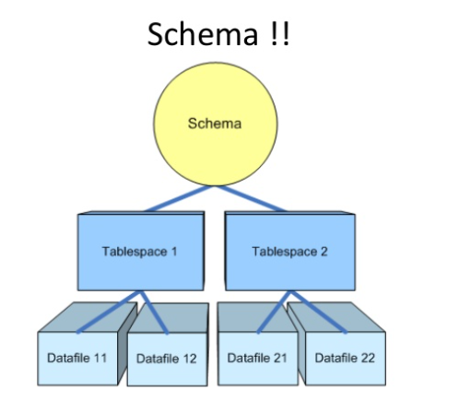

Slide 11
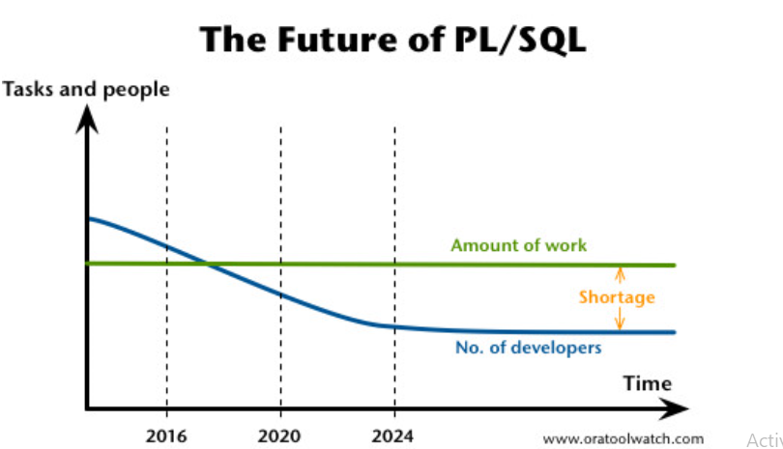

Slide 12
Reference
https://www.slideshare.net/BilalArshad42/introduction-to-oracle-database-basic-concepts
Linkedin website
Wikipedia
Oracle PL/SQL World (Youtube channel).
Tutorials Point (Youtube channel).

